Slide 2
" In The Name of Allah, The Most Beneficent, The Most Merciful" Islam and genetically modified foods (GMOs) By: Dr. Hani M. Al-Mazeedi

Slide 3
Scope
This presentation gives a summary on genetically modified foods (GMOs) when the DNA of any part of its ingredient has been manipulated.
© Halal Sciences Academy Limited

Slide 4
Content
Definitions
Halal & Haram In Islam
Question & Answers
© Halal Sciences Academy Limited

Slide 5
Definition
Genetically modified foods (GMOs) are whole food or products that the DNA of any part of its component has been manipulated.
© Halal Sciences Academy Limited

Slide 6
What does it mean?
GMOs involve the transfer of genes between species
Example:
A vegetable product may contain a DNA material from Animal.
© Halal Sciences Academy Limited

Slide 7
Effect of genetic modification on Food
Altering an organism’s DNA can affect traits or behavior.
© Halal Sciences Academy Limited

Slide 8
Example
height, weight, and color.
improved insect-resistant crops.
withstand certain weather and soil conditions.
© Halal Sciences Academy Limited

Slide 9
What does that mean?
The new genetic material will be inherited by the organism’s offspring.
© Halal Sciences Academy Limited

Slide 10
In addition
GMOs are also products from which some of its original DNA has been removed.
For example removing the DNA that is responsible for production.
© Halal Sciences Academy Limited

Slide 11
Example of this technology is the:
Terminator technology or suicide seeds, is the name given for restricting the use of genetically modified plants by causing second generation seeds to be sterile.
© Halal Sciences Academy Limited

Slide 12
Example of this technology is the:
Sterile Seeds (Seeds will only produce one yield crops).
The formation of the seed is part of the process of reproduction in seed plants
© Halal Sciences Academy Limited

Slide 13
The Holy Quran
Allah the almighty said in the holy Quran in surat Al-Ma’idah Aya 5:88:
وكلوا مما رزقكم الله حلالا طيبا واتقوا الله الذي انتم به مؤمنون
The meaning of the translation of this Aya is: “Eat of the things which God hath provided for you, lawful and good: But fear God, in whom ye believe.
© Halal Sciences Academy Limited

Slide 14
What is the message
We should not only focus on Halal food by avoiding Haram food but we must also focus on good food as well.
© Halal Sciences Academy Limited

Slide 15
Is GMOS harmful (i.e. make food not healthy)
With GM Foods there is no scientific evidence yet that they are harmful to human health.
© Halal Sciences Academy Limited

Slide 16
Where is the concern
For Muslim consumer, the issue with GMOs, however, not only with its safety but with the sources of their DNA material (Haram or Halal).
And from this point Muslim require the labeling on all of the GMOs products.
© Halal Sciences Academy Limited

Slide 17
Labeling GMOS is important
GMOs foods remain unlabeled in supermarkets, making it nearly impossible to determine intact mother nature products from the scientific man-made origins of our food.
© Halal Sciences Academy Limited

Slide 18
Something New to Consider
GMOs are something new for Muslim theologians & scholars to consider, especially when it relates to food products.
© Halal Sciences Academy Limited

Slide 19
Halal & Haram In Islam
To determine whether GMO products are Halal or not, one has to go to the principles of Halal (lawful) and Haram (forbidden) in Islam, as guided by the Quran and the Hadith, while observing the following principles:
© Halal Sciences Academy Limited

Slide 20
Does not contain any part or product of animal origin of uneaten meat (meats that Islam forbid to eat).

Slide 21
2. Does not contain any part or product of animal origin of eaten meat (meats that Islam Allow to eat) that are not slaughtered according to the requirements of Islamic law.

Slide 22
3) Does not contain a component by definition of Islam is unclean (Najis ).

Slide 23
4) Is safe and not harmful.
5) Not produced by tools or equipment contaminated by unclean materials(Najis).

Slide 24
6) The raw ingredients of the product does not contain derivatives of human being.

Slide 25
7) During preparation, processing, packaging, storage and transportation Halal products are separated from any other product that does not meet the conditions mentioned above.

Slide 26
What is the verdict?
GMO products are lawful if they are originating from lawful sources, including genes from lawful animals.

Slide 27
What is the verdict?
GMOs become Haram, or highly questionable, if they originate from unlawful sources such as genetic material from unlawful animals such as pigs or dogs or produced in Najis medium.

Slide 28
What is the verdict?
An unlawful GMO product may become lawful in times of emergency, such as in the case of avoiding starvation or an illness leading to death. The intake should be limited only to necessity.

Slide 29
What is the verdict?
However, the use of unlawful DNA at present in our food, drink, and usable goods (Cosmetics & Medicines) does not meet the emergency criteria, as alternative sources are available.

Slide 30
Question & Answers

Slide 31
Q&A
Question: Do GMO products from Najis sources are also Najis?
Answer: Yes.
Because they have been initiated from Najis raw material.

Slide 32
Q&A
Question: Do GMO products from Najis sources such as pig or dog may be allowed for external use under normal circumstances?
Answer: Big No.
Because forbidden Najis products from eating are also forbidden from utilization such as external use.

Slide 33
Q&A
Question: If a physical element of Najis products such as pig or dog cannot be detected or traced in the product, whether during processing or in the finished product, will that make the finished product Halal?

Slide 34
Q&A
Answer: It Is Haram.
Because the ignorant existence of Haram products is not an issue, the issue here is if we know for sure that a Najis raw material is contained in a product then the finished product is also Najis (Haram).
Why? Because these Najis products in our knowledge are contained in these products?

Slide 35
Q&A
Question: GMO food is everywhere, it is cheaper and cannot be avoided.
Would it be wastage –israaf to buy food that is not GMO processed and it costs twice to three times more than GMO products?

Slide 36
Q&A
Answer: As long as their are no reports on GMO products that cause Harm to human’s health or has been initiated from Haram sources then it is considered as Halal to purchased and consumed.

Slide 37
Q&A
Question: If GMO products still questionable whether or not Harmful, and that evidences are inconclusive and needs additional studies, in addition, there were no reports of GMOS’ DNA sources as Haram, can we purchased them and eat them?

Slide 38
Q&A
Answer: As a general rule, the origin of things are Halal unless forbidden by Islam. Questionable GMO products considered as Mashbooh products. Purchasing or eating Mashbooh products will not be a sin, but it is advisable to avoid Mashbooh products to safe guard our self from falling into the restricted area of Haram.

Slide 39
Q&A
Question: Would GMOs considered as an attempts to modify living things (i.e. Tampering with nature)? If so then would that be considered as a sin?

Slide 40
Q&A
Answer : if the purpose behind the modification is essential and for the public interest, such as to promote the welfare of all¹, or to prevent harm², then such modification is permissible.
1-feed the hungry by improving crops, fish or livestock. Producing healthier foods with extra nutrients or vitamins.
2- to reduce reliance on pesticides and herbicides, which pollute the environment

Slide 41
Q&A
Question: Is it ok to deal with GM food producers that claims legal ownership over their GM products i.e. they produce seeds that will only produce one yield of crops?
I.e. if we purchase from them are we supporting Monopoly?

Slide 42
Q&A
Answer: If alternative sources are available then it would be advisable not to purchase from Monopolizing companies. Purchasing from Monopolizing must be limited to only a crisis situation.

Slide 43
Q&A
Question: From a Muslim Perspective, is GMO labeling necessary? As some governmental bodies believe that GMO labeling may suggest to consumer a health risk where there is none.

Slide 44
Q&A
Answer: GMO labeling is necessary
It is the consumer right to know what is in his food, cosmetics, skin care products, and Medicine.
All types of Labeling must be under strict and close supervision of Halal services provider.

Slide 45
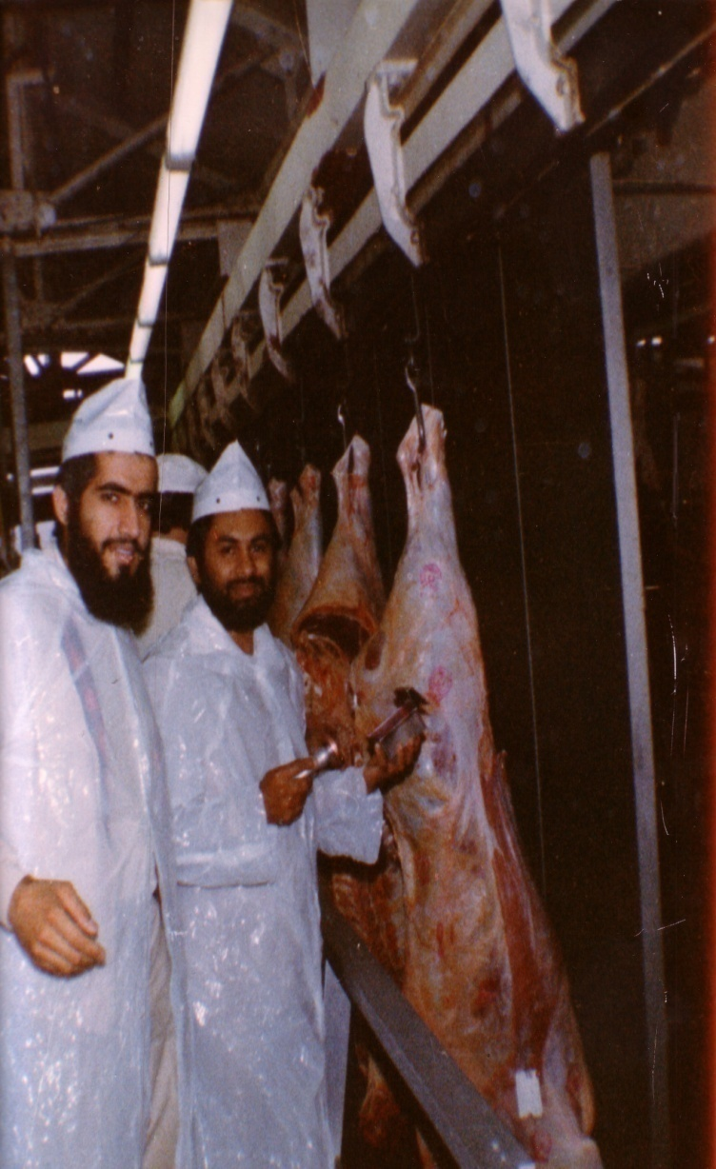
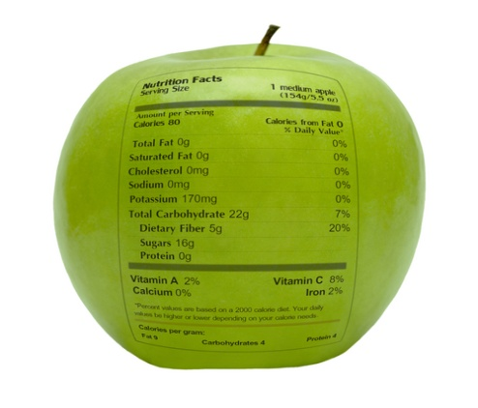
شكراً لاستماعكم
سبحنك اللهم وبحمدك أشهد أن لا إله إلا أنت، أستغفرك وأتوب إليك
د. هاني منصور المزيدي
مع الأخ أمجد محبوب في أستراليا سنة 1981
Dr. Hani Mansour Al-Mazeedi
With brother Amjad Mahboob in Australia in 1981

Slide 46
www.HalalEA.com
Trademarks, icons, images belong to their respective owners.
© Halal Sciences Academy Limited

